Slide 1
Sprint 1 Presentation
Rajeshree Pohokar

Slide 2
CONTENT
Case Study Statement
Implementation
Flow of Web Development
Features

Slide 3
Case Study on E-Commerce Website
1.Create a web api in DOT NET
2.Create database in Sql server
3.Create web app in angular
Features:-
User Section
1.User can register and login
2.He can purchase product through COD
3.User can see the product
Admin Section
1.Admin can login and add categories
2.can see all orders placed by the customer and customer details
3.admin can add products
Company
Context
Problem statement

Slide 4
Implementation

Slide 5



Database:
SQL Server
Front-end:
Angular
Back-end:
.Net Web API

Slide 6
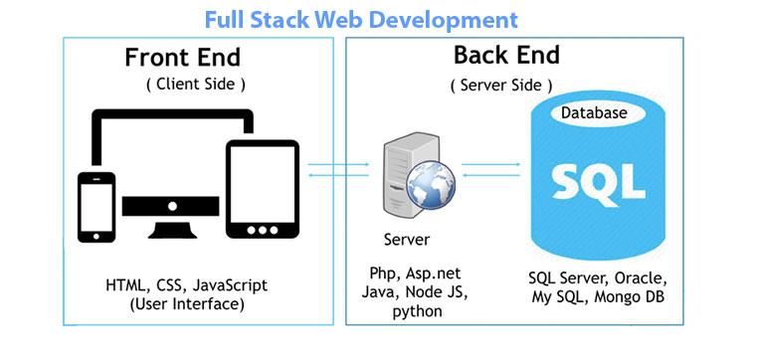

Slide 7
Features of E-Commerce Website
In this project I have used angular as a front end / client side.
I have used C# as a programming language and .NET API as a backend server.
I have also used Microsoft SQl Server Management Studio to create Database and Tables.
Web Api is an intermediate between frontend side and database.
User can be Register and Login on the website .
User can see products in the “My Account” after login
User can also add products to the Cart.

Slide 8
THANK YOU

